Slide 1
Manchester
Raspberry Jam 21
July 2014

Slide 2
Last Time...

Slide 3
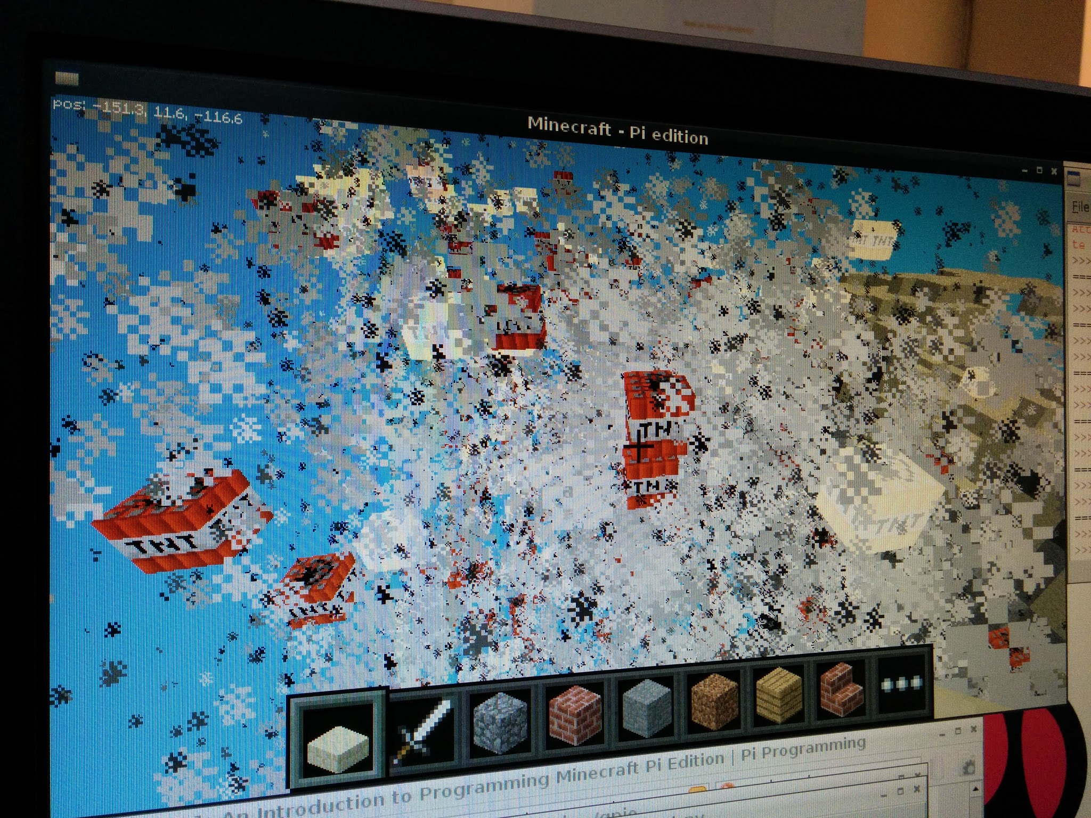
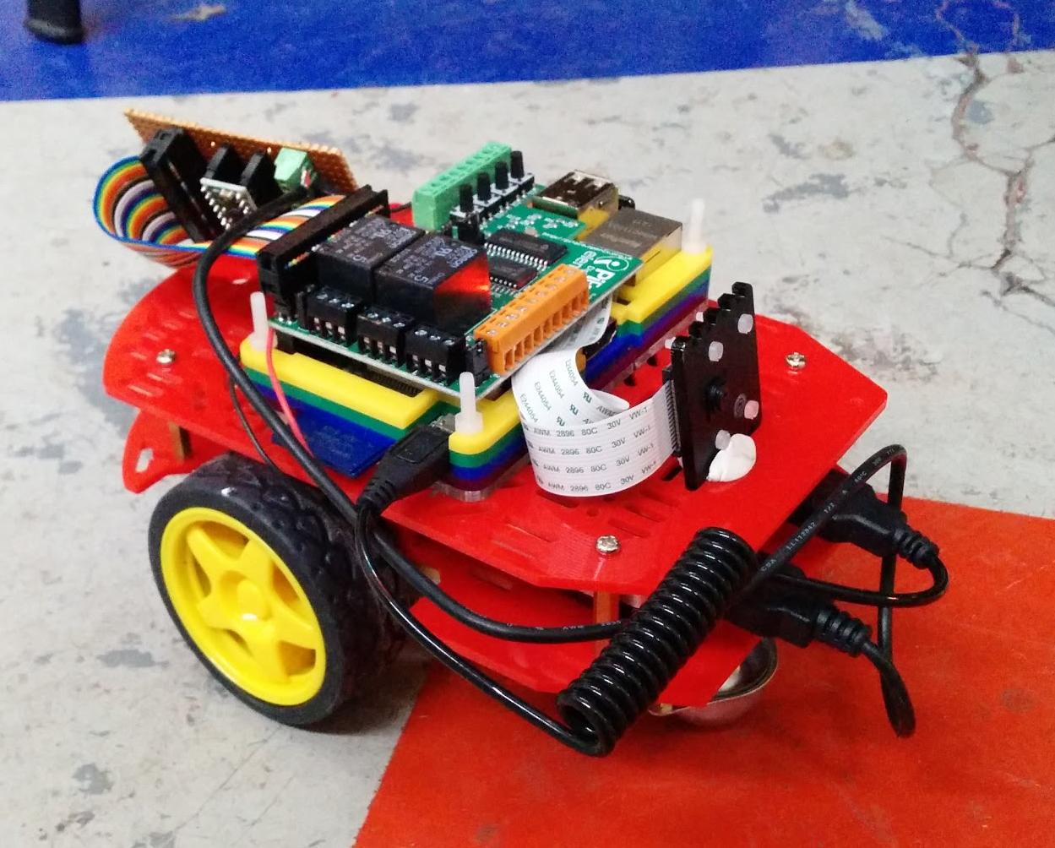
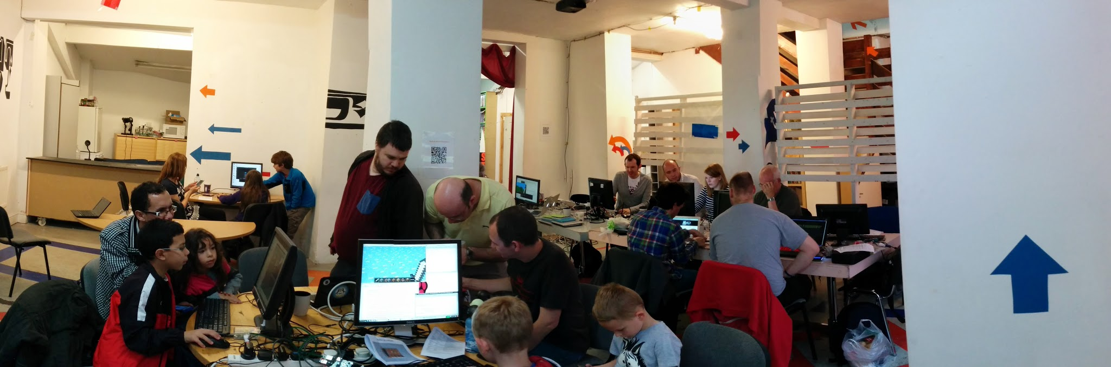
Manchester Raspberry Jam 20

Slide 4
In The News...

Slide 5
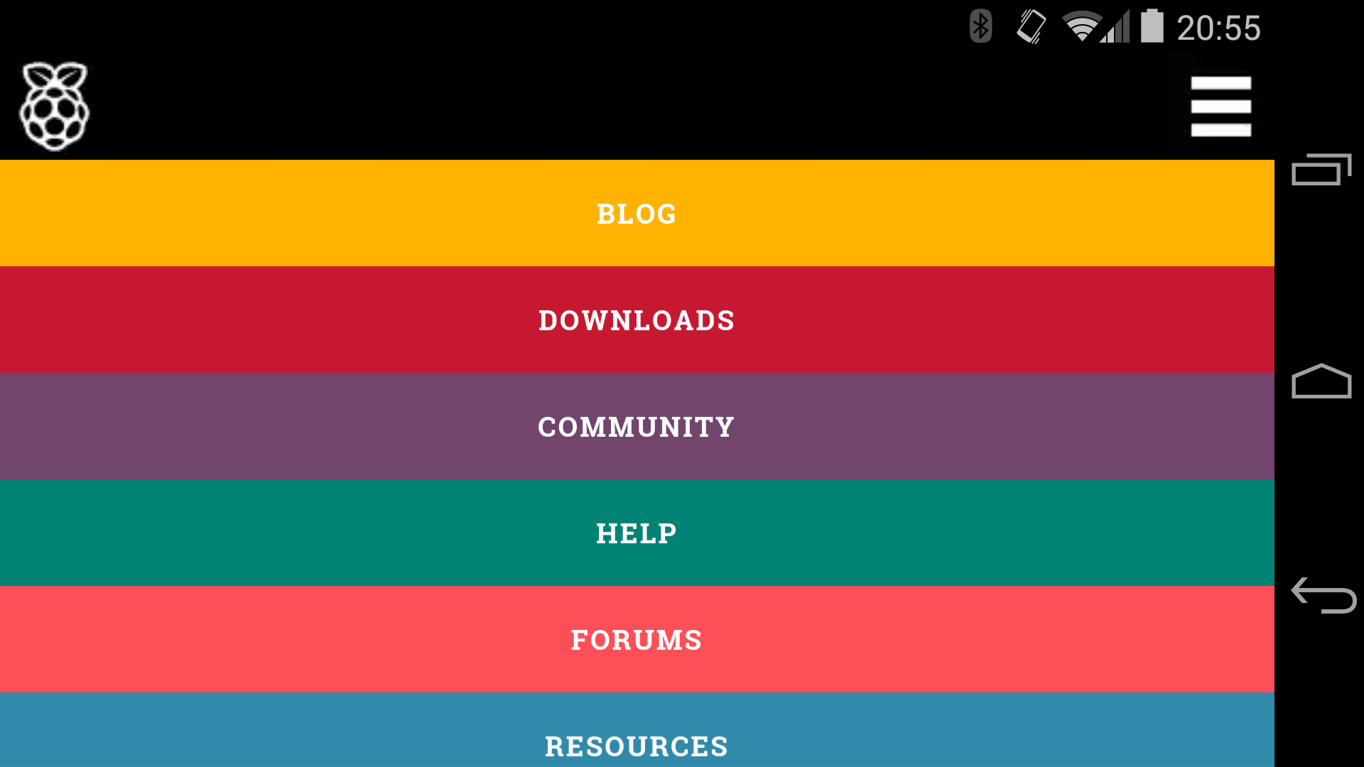
New Raspberry Pi website for mobile
https://twitter.com/ben_nuttall/status/487566469598035968

Slide 6
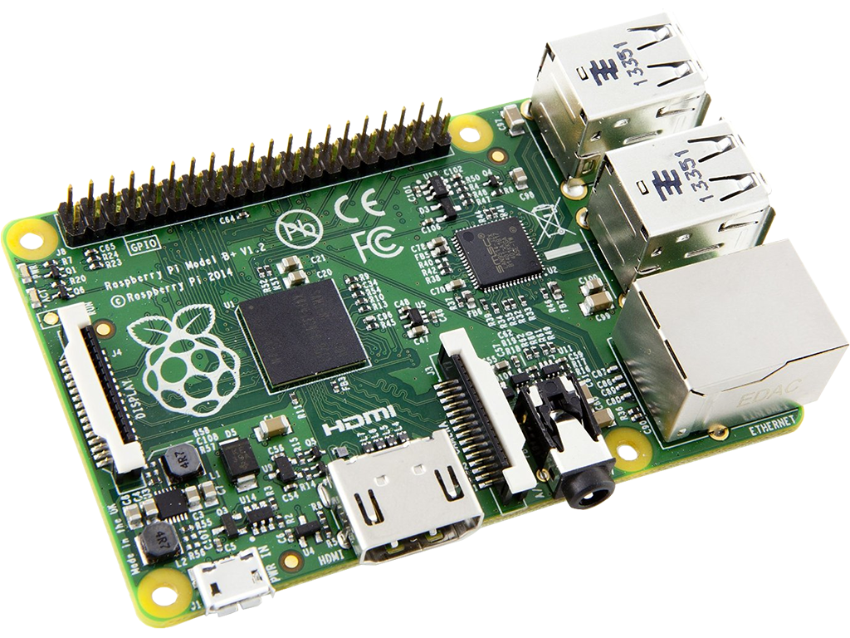
Model B+
http://www.raspberrypi.org/introducing-raspberry-pi-model-b-plus/

Slide 7
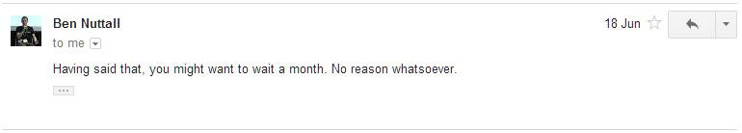
Model B+
http://www.raspberrypi.org/introducing-raspberry-pi-model-b-plus/

Slide 8
Projects...

Slide 9
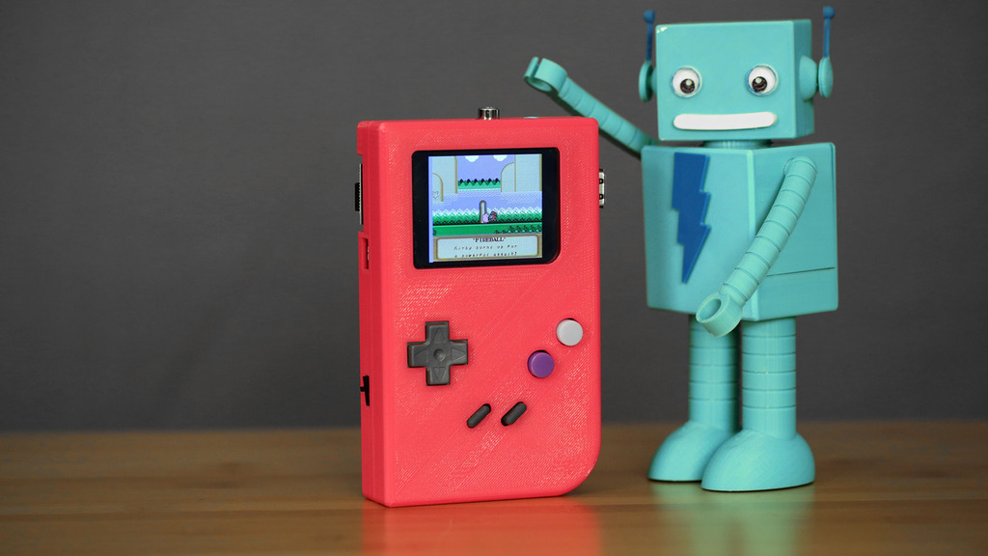
PiGRRL - Raspberry Pi Gameboy
https://learn.adafruit.com/pigrrl-raspberry-pi-gameboy?view=all

Slide 10
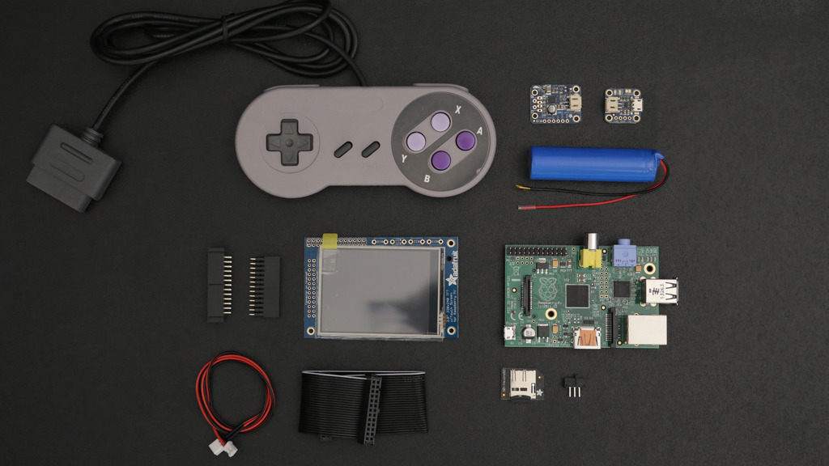
PiGRRL - Raspberry Pi Gameboy
https://learn.adafruit.com/pigrrl-raspberry-pi-gameboy?view=all

Slide 11
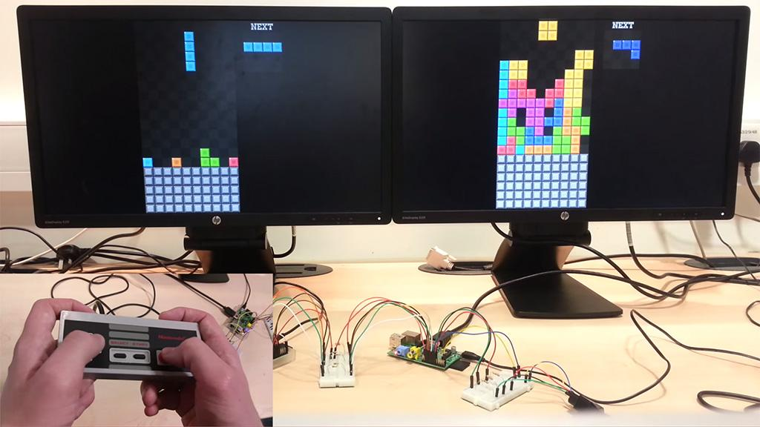
Bare metal Tetris
http://www.raspberrypi.org/bare-metal-tetris-duel/

Slide 12
Coming soon...

Slide 13
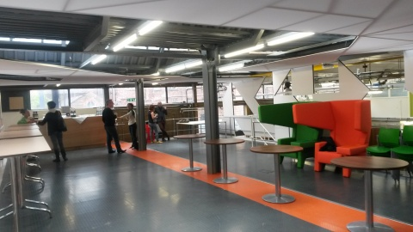
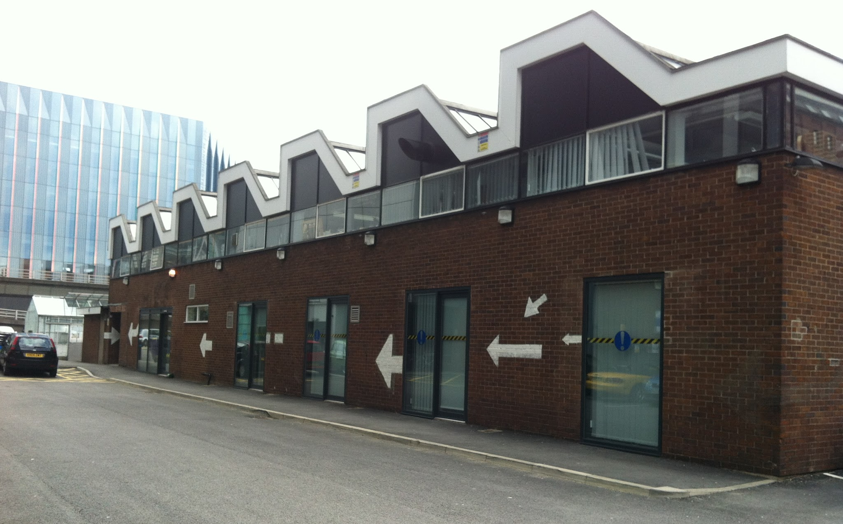

Manchester Raspberry Jam 22

Slide 14
For today...

Slide 15
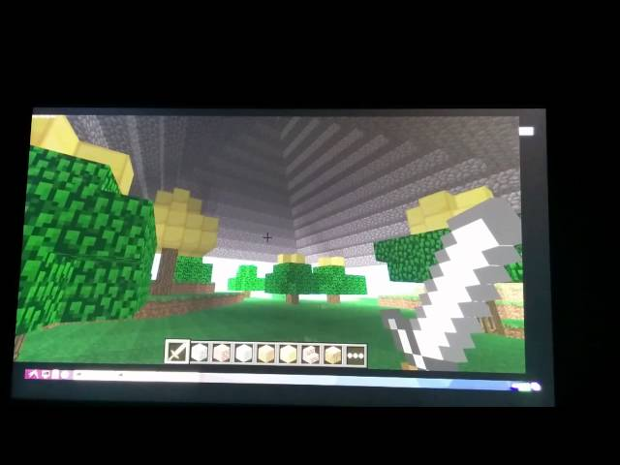
Ideas: more Minecraft!
http://www.raspberrypi.org/introducing-raspberry-pi-model-b-plus/

Slide 16
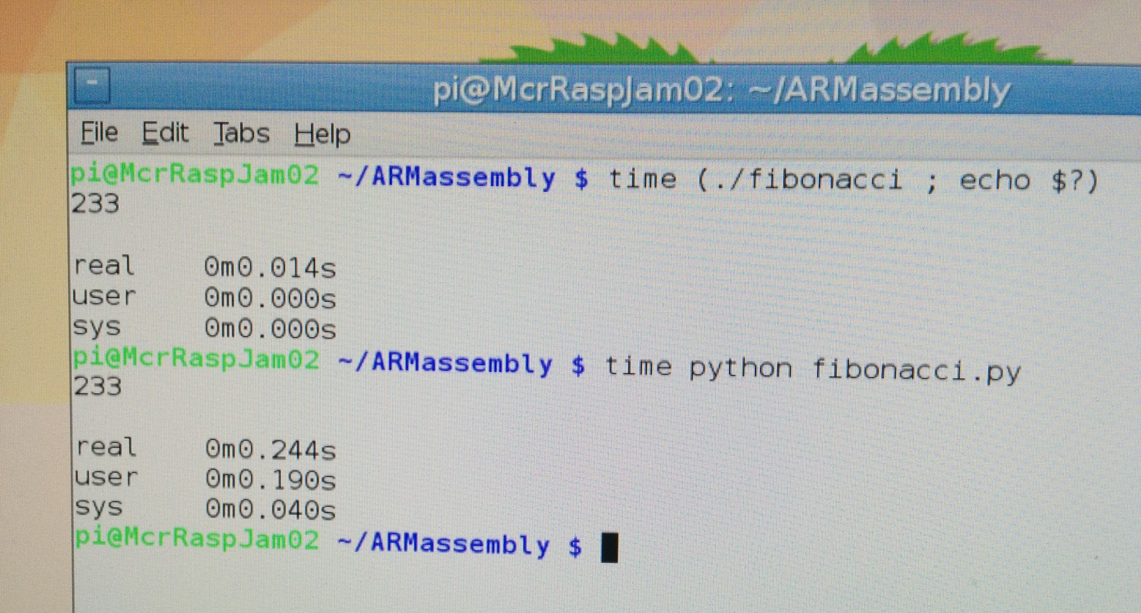
Ideas: ARM assembly
http://www.raspberrypi.org/introducing-raspberry-pi-model-b-plus/

Slide 17
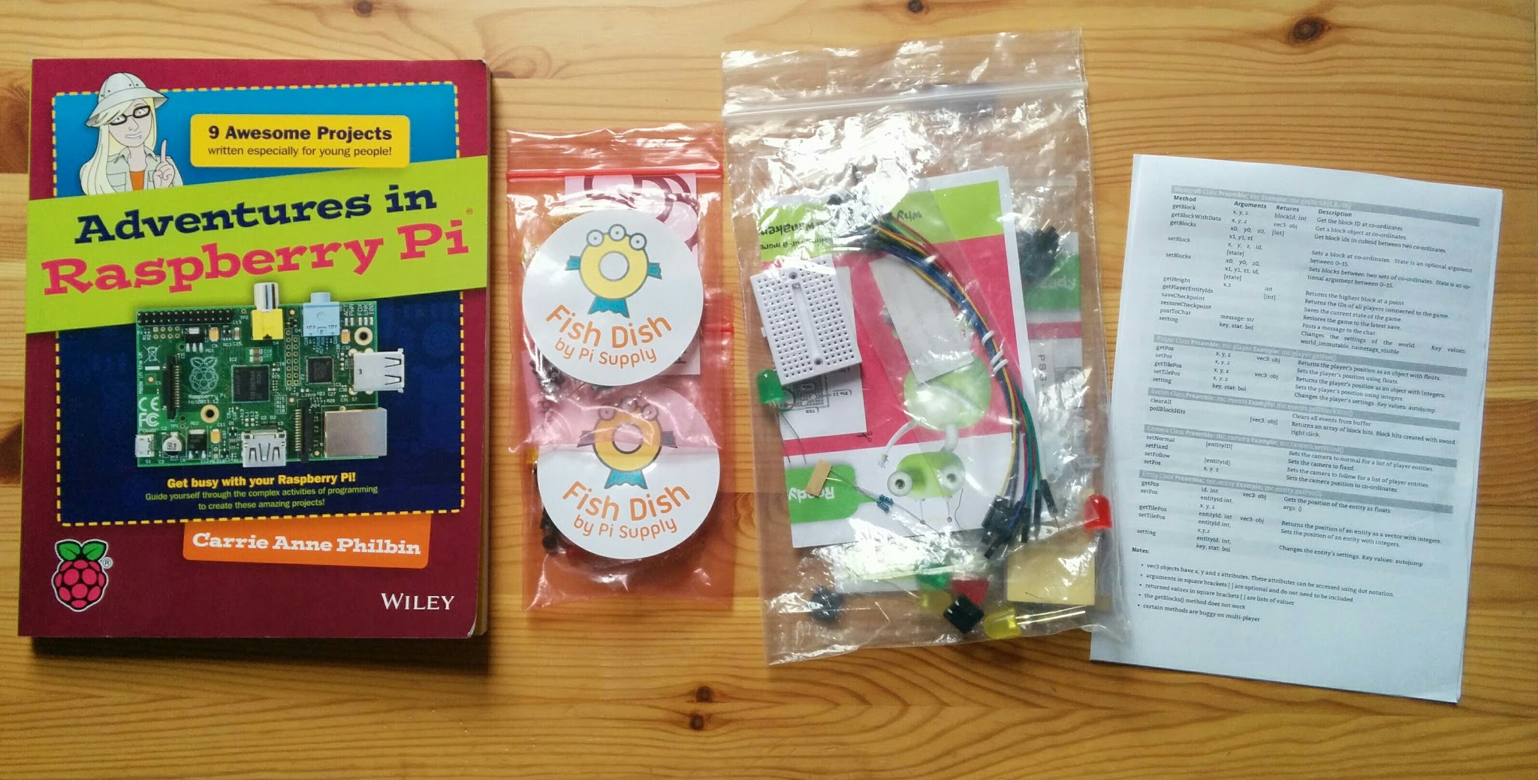
Ideas: everything else
http://www.raspberrypi.org/introducing-raspberry-pi-model-b-plus/

Slide 18
Today:
Both floors available
Pizza at ~1pm

Slide 19
Thanks to our sponsors:
Tom Broughton
Dave Jones
Rosemary Williams

Slide 20
Finally...
Tweet your photos and creations:
#McrRaspJam
Download the slides:
http://bit.ly/McrRaspJam21

